Slide 1
New Tapas Bar in Madrid
Carlos Moreno García
May 2020

Slide 2
Introduction
Open a new Tapas Bar in the center of Madrid
Parameters:
Area: inside the M30 (city center)
Location: a neighborhood with a lot of social life, but no too close to the other Bar (150 meters minimum)
Clients age: between 30 and 50 years
Dimensions of the local: between 50 and 100 m²
Budget to buy the local: 150.000€ max
Budget to reform the local: 50.000€ max

Slide 3
Data sources
Explore all the venues for Tapas Bar in Madrid, inside the M30, with www.foursquare.com
Choose the 2 or 3 neighborhoods with more Tapas Bar.
Check to local price per m² for each neighborhood. We check the www.idealista.com database.
It should fit the equation price/ m² < 3000€ since the maximum budget to buy it is 150.000€ and the minimum size is 50 m²
Choose the neighborhood that’s fit best the previous parameters , then looking for free locals for sale that meet the budget and the location constrains.
With the list of candidates, evaluate the around Tapas Bar users, to apply the parameters criteria.
Propose to the client the local that fits all the parameters most recommended.

Slide 4
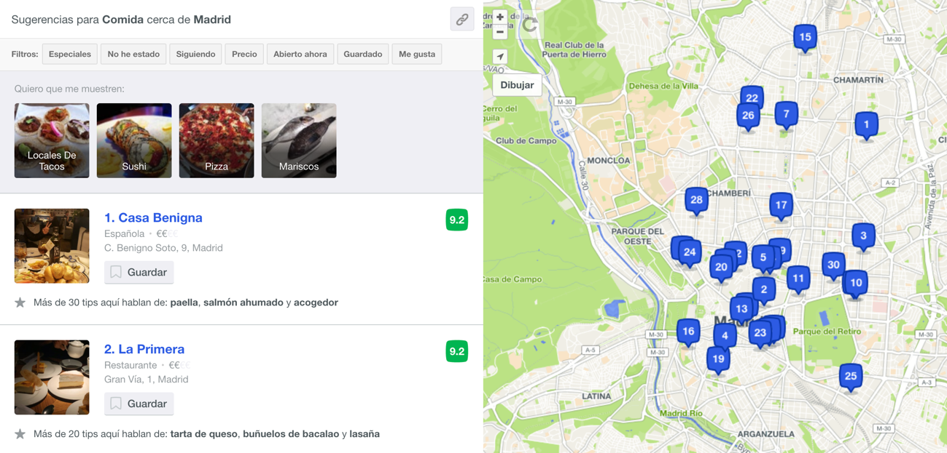
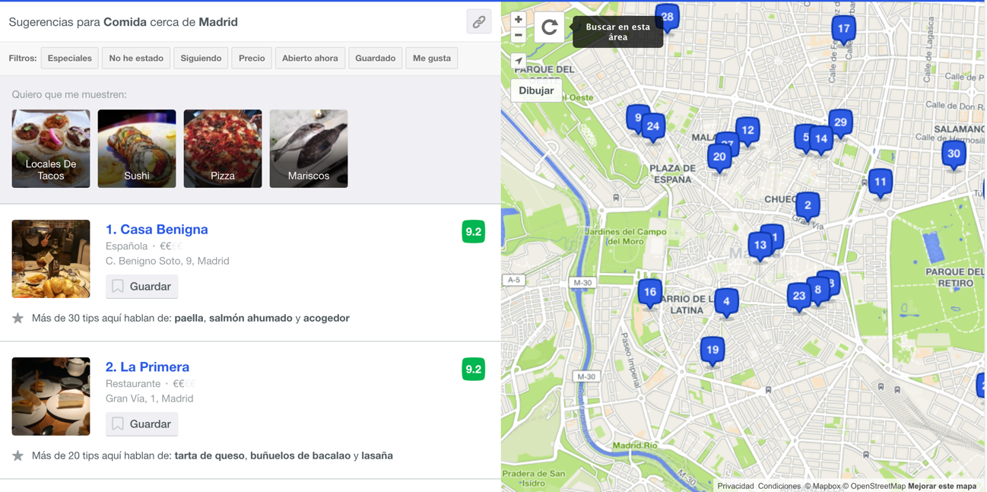
Data analysis
When you get closer to the center there is more concentration of bars”

Slide 5
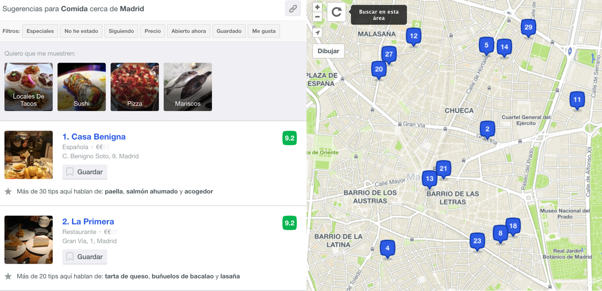
3 neighborhoods candidates to establish the new bar:
“Barrio de las Letras”
”Chueca”
“Malasaña”

Slide 6
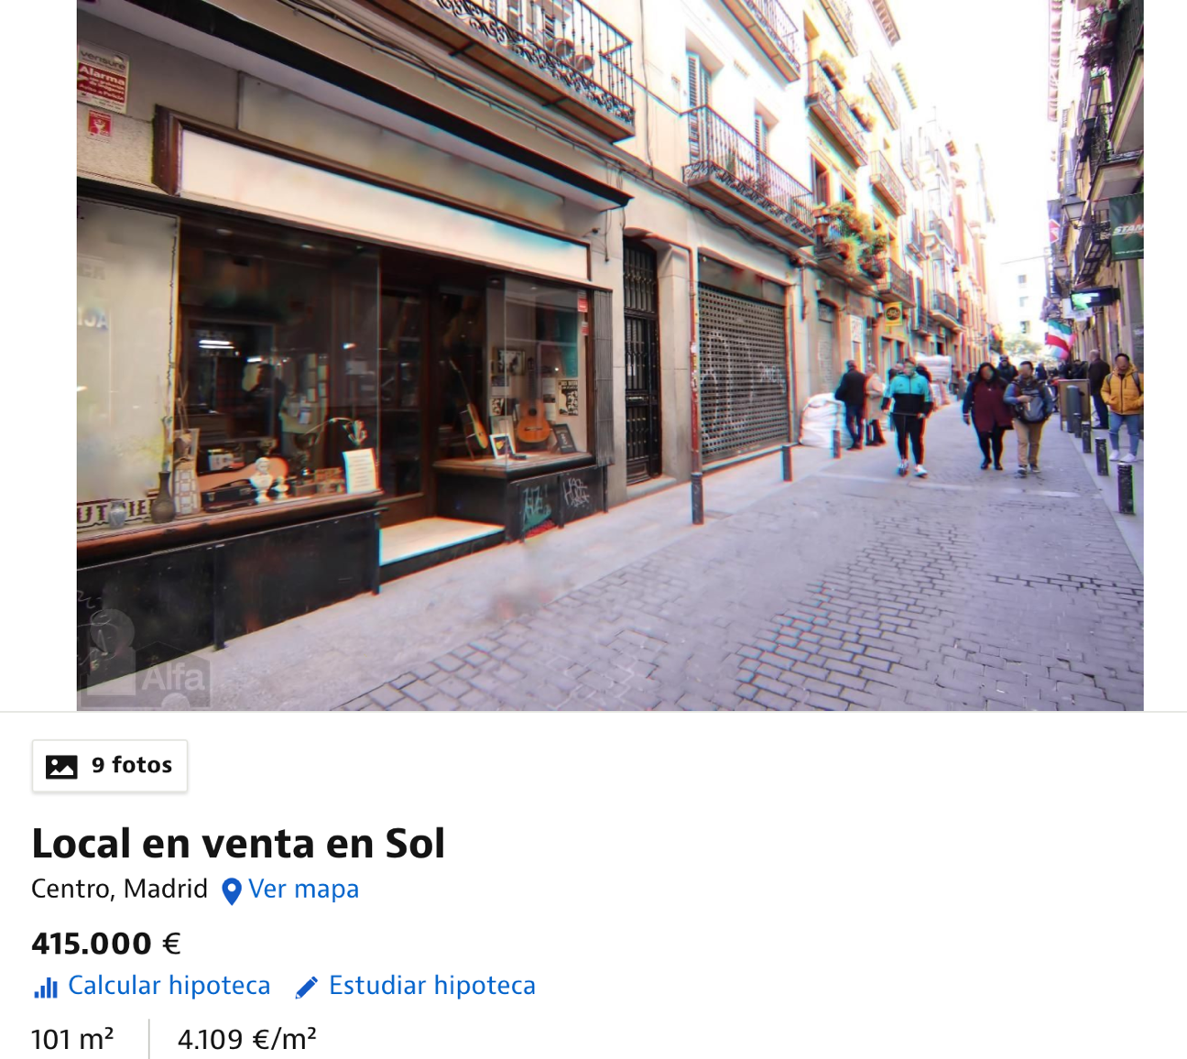
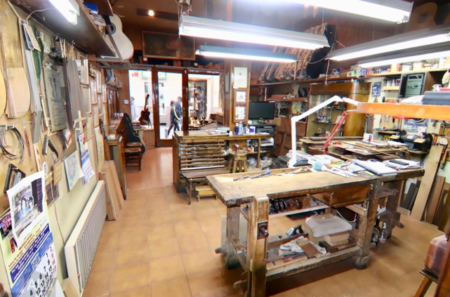
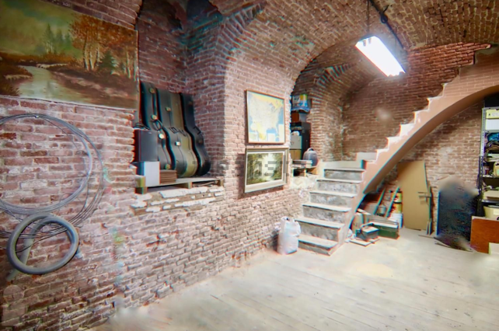
Conclusion
101 m²
200m from Center
415.000€
2 floors
Style vintage
The more solicitated área for social life in Madrid
4109€/m²
The 4º best €/m²

